Slide 1


Enjoy the beautiful Neurons
Lijuan Liu
Annotation Group

Slide 2
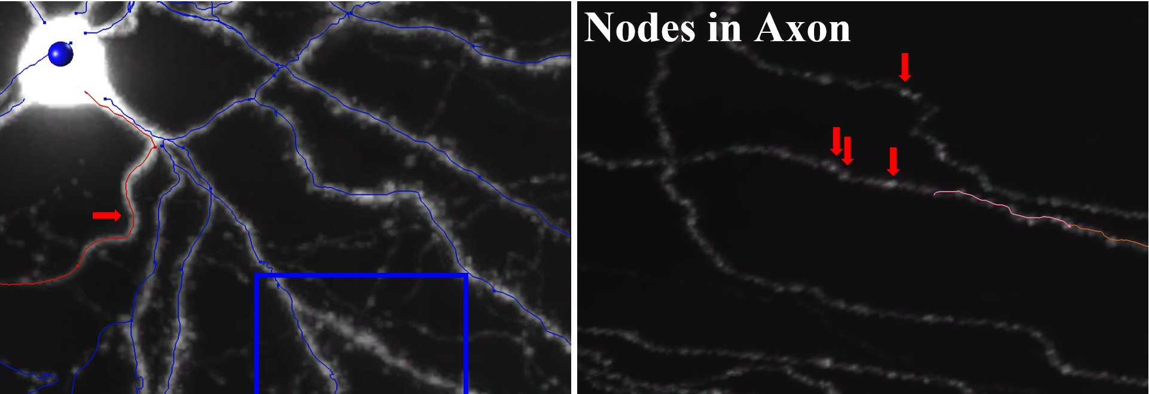
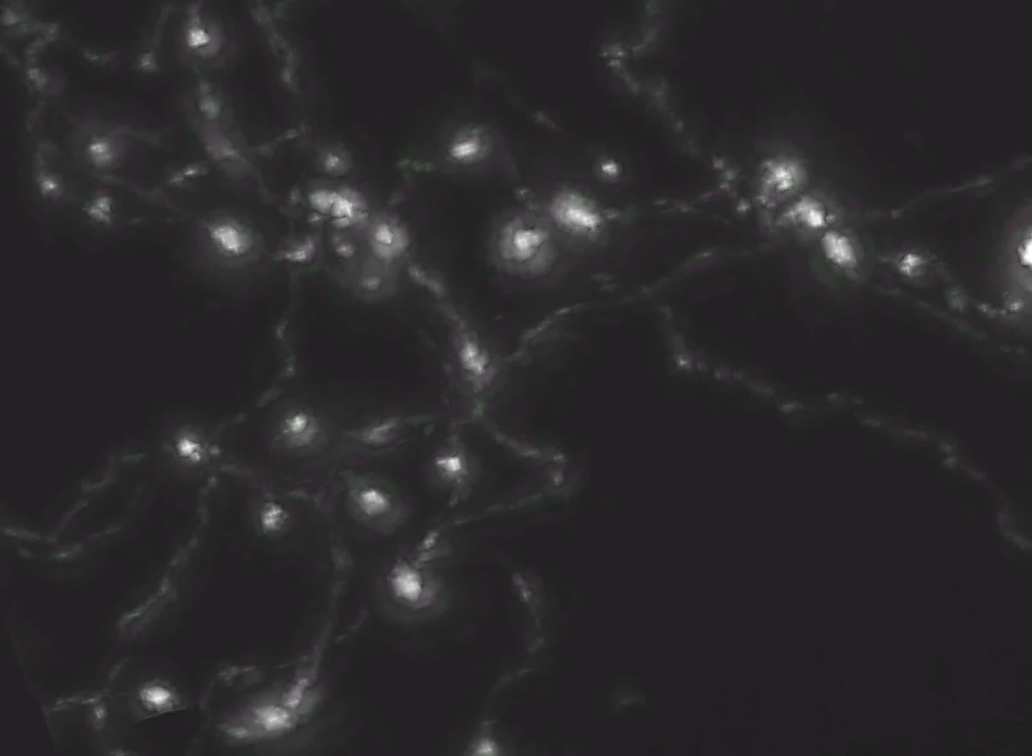
Questions(Q) & Answers(A)
Q1：How to distinguish the axon and dendrite?
A1：Usually axon is smooth when coming out the soma, but there are many small protrusions on the surface of dendrites called dendritic spines, which are the primary postsynaptic targets of excitatory glutamatergic synapses. Sometimes, axon could project from the primary dendrite, however, it’s rare.
Axons branch at the terminal part. For the terminal of axon, there are large nodes could be sites for synapse. Also, large nodes are probably shown in middle too.
Red-Axon
Blue-Dendrite
Bouton of Axon Terminal

Slide 3
Q2：How to check the location of the neurons?
A2：go to www.brain-map.org and… papers
Q3：Do Axons usually get branches at the terminal part?
A3：NO, could be in the middle

Slide 4
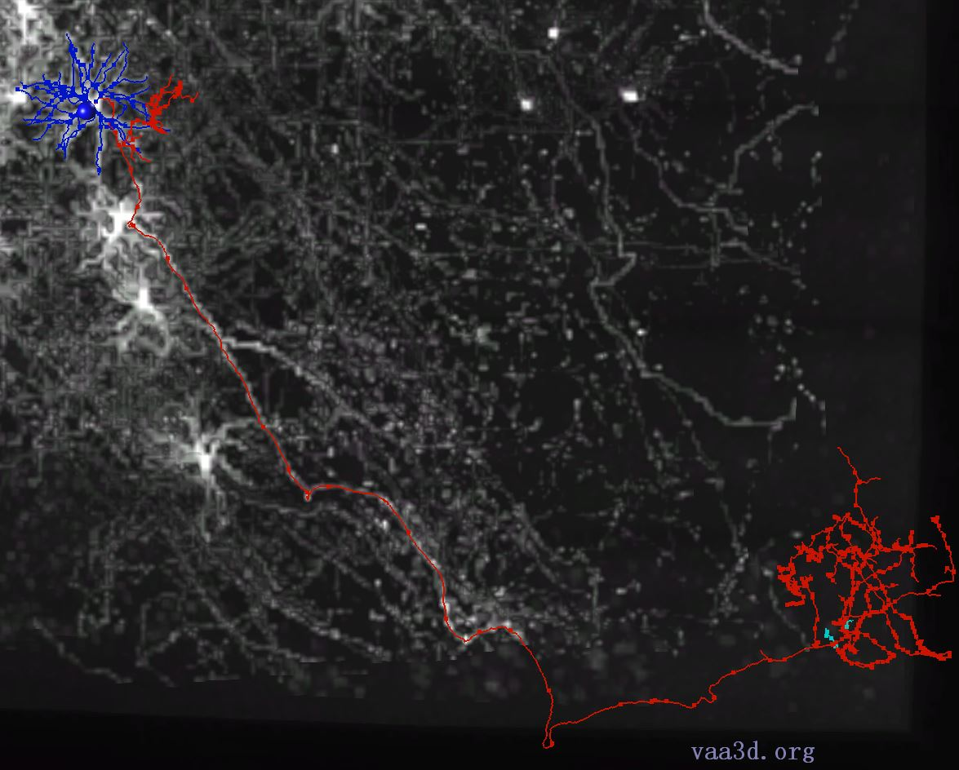
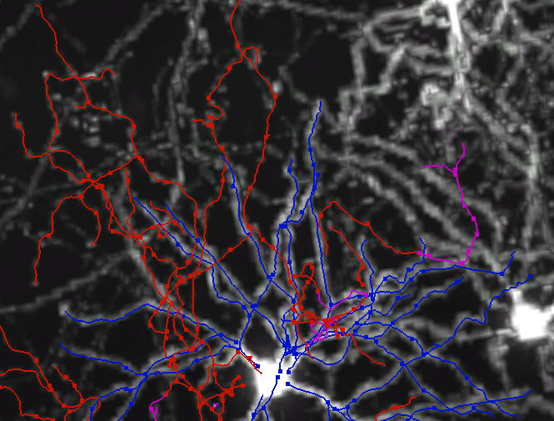
Q4: Is it possible for the axon branches from the soma area go back to soma area?
A4: YES! The neurons located at the Striatum show this morphology, they are excitatory neurons. The yellow arrow points to the branches of the axon nearby the soma which do not project away from soma.
Axon branches
nearby Soma
Axon branches
around Soma

Slide 5
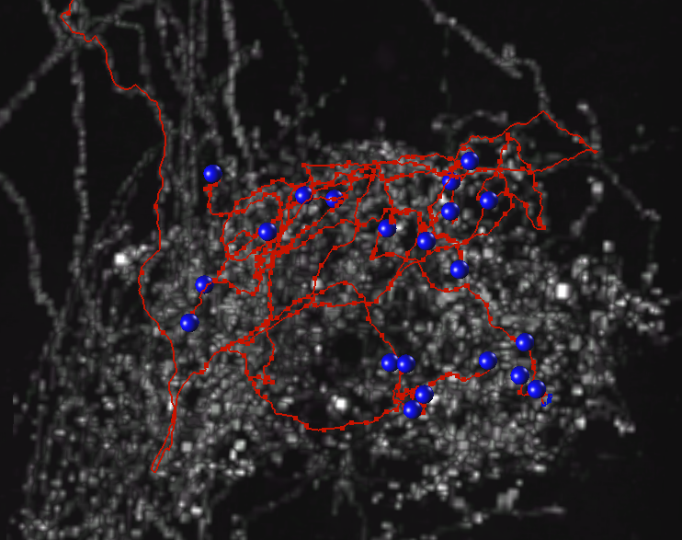
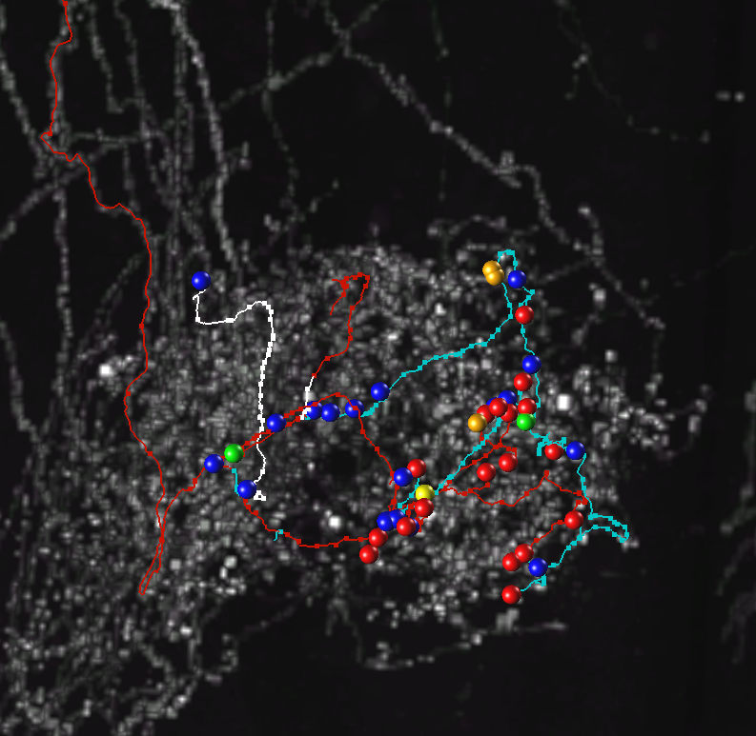
Q5:Is it possible for the axon branches to have an obtuse angle?
A5: It’s unusual to have these type of branches. They could be branches from other neurons. Please pay attention to the terminal primary branches. If you get wrong primary branches, it will take a lot of time to trace the wrong branches.
Wrong
Right
The white arrow points to the wrong secondary branch. The angle is not good.

Slide 6
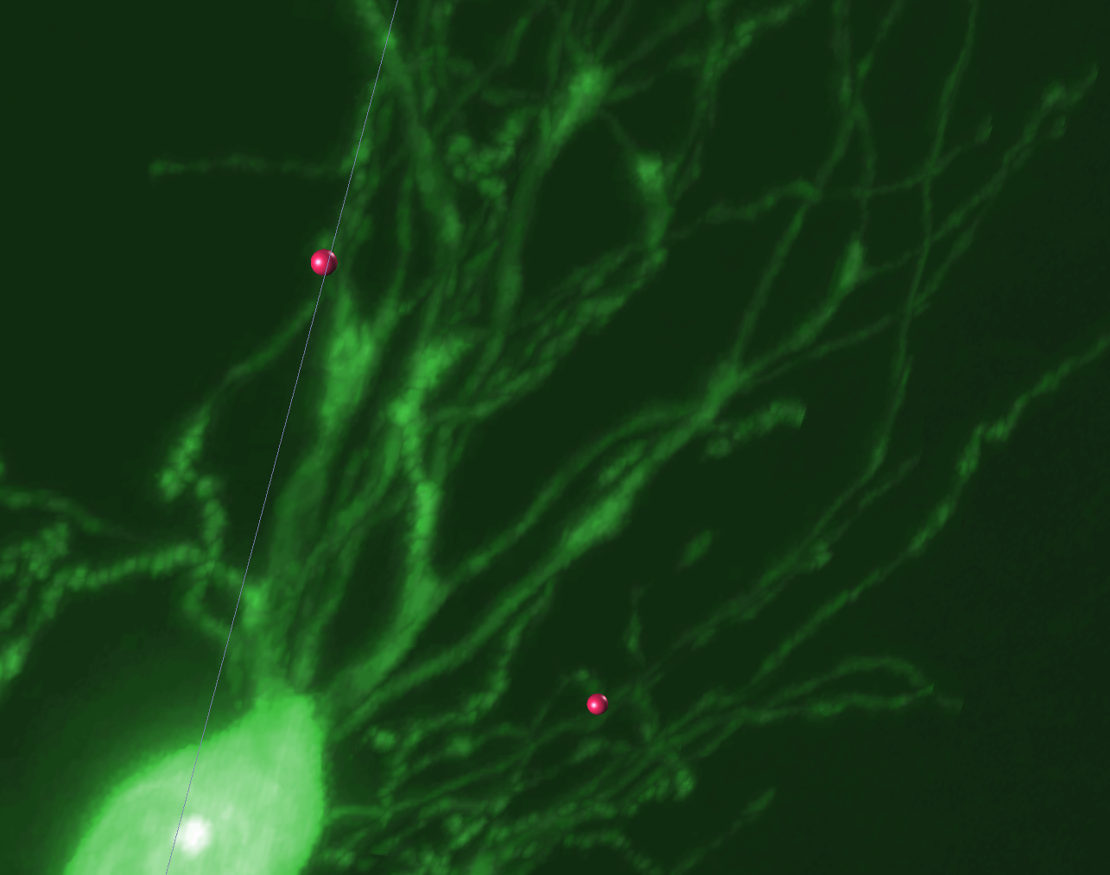
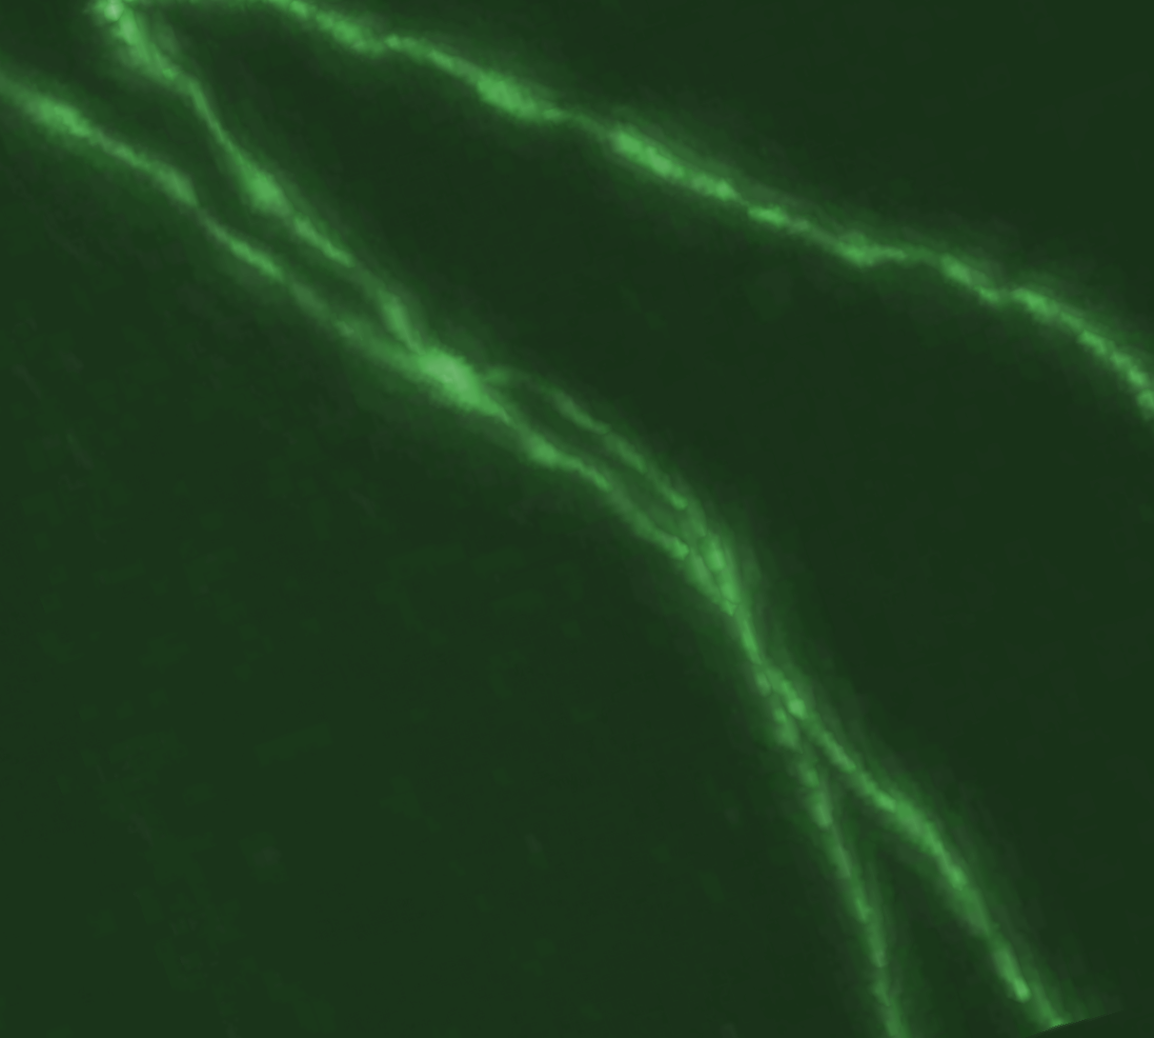
Annotation Tricks
1, Be careful of the distribution and numbers of Dendrites from soma.
These characteristics distinguish the type of neuron.
2, Pay attention to the axon branches of nearby Soma.
3, Right angle-connections are unusual. Maybe wrong tracing from two neurites.
4, Crossing neurites are usually straight lines, Obtuse-angle connecting can a sign of wrong connections.
5, It will be easy to check missing branches when lock the area.
038
Large Node coming out several Dendrites
Axons from two neurons cross, and
forms a node.

Slide 7
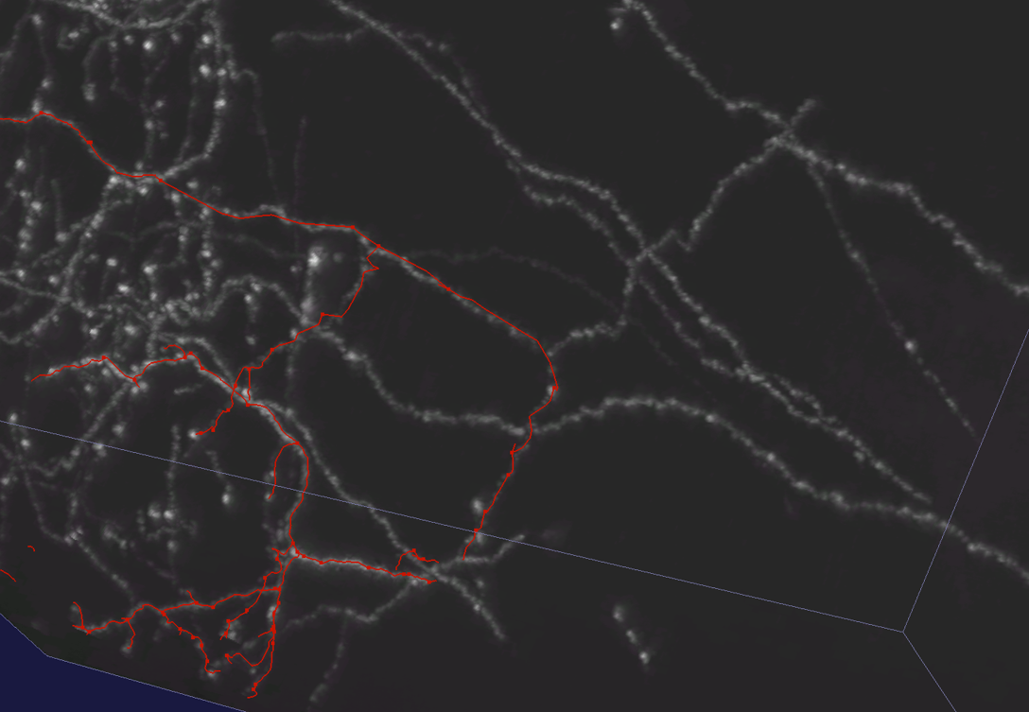
Annotation Tricks
6, Axon can emerge from a dendrite. It’s rare though.
7, It’s hard to identify the neurites' origin when two neurons are too close. USE VR!
8, Usually there is no trifurcation in an axon. If it shows up, could be features for the neuron, or when the neuron is in a dynamic status.
9, During tracing the Long Axon Projection, markers should be set for nodes along the way. It will be easier for checking the branches. Colors of nodes could stand for different status. Red-Unfinished, Blue-finished.
Pay more attention to the weak branches along the axon projection.
Missed branches

Slide 8
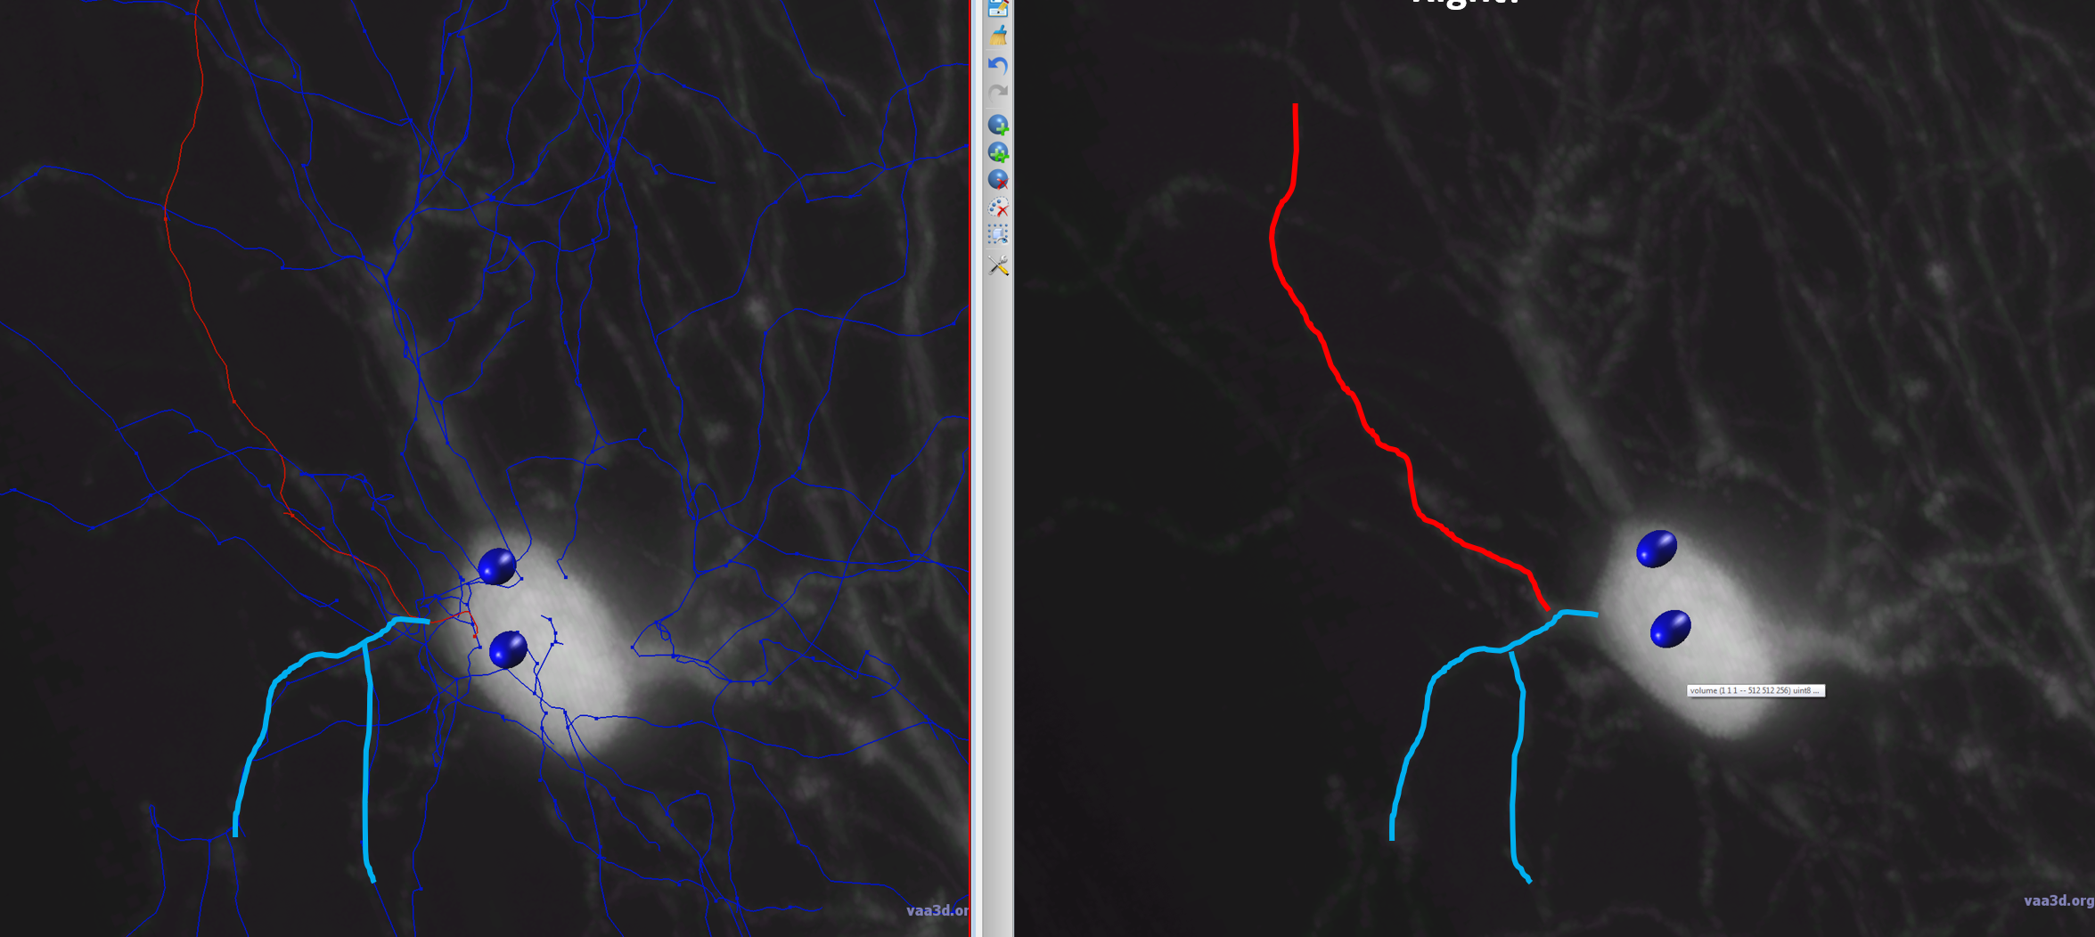
120: An axon emerged from a dendrite that emerged out from a soma (not the other way)!
Wrong
Right

Slide 9
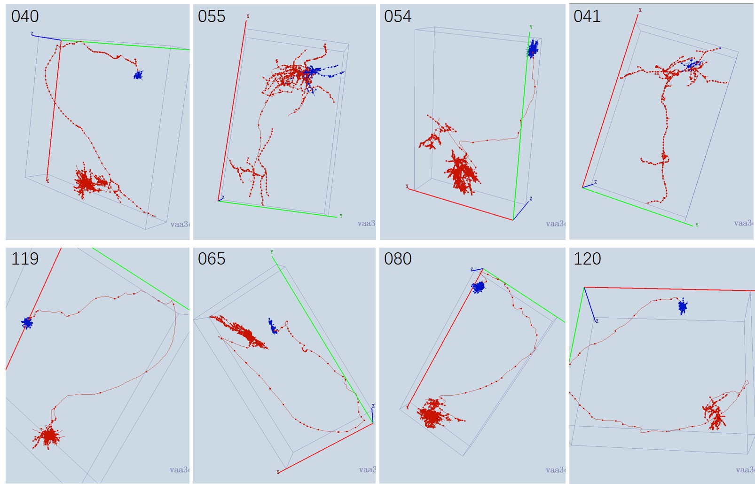
Examples

Slide 10
Your Annotation tricks will be welcome to add here

